Slide 1



PHISHING ATTACK
BY : MRIGANKA DAS
REG. NO. : 12016847

Slide 2
What is a phishing attack?
Phishing is a type of social engineering where an attacker sends a fraudulent (e.g., spoofed, fake, or otherwise deceptive) message designed to trick a person into revealing sensitive information to the attacker or to deploy malicious software on the victim's infrastructure like ransom ware. Phishing attacks have become increasingly sophisticated and often transparently mirror the site being targeted, allowing the attacker to observe everything while the victim is navigating the site, and transverse any additional security boundaries with the victim.
Types of Phishing attack
Email phishing
Most phishing messages are delivered by email spam, and are not personalized or targeted to a specific individual or company–this is termed "bulk" phishing. The content of a bulk phishing message varies widely depending on the goal of the attacker–common targets for impersonation include banks and financial services, email and cloud productivity providers, and streaming services. Attackers may use the credentials obtained to directly steal money from a victim, although compromised accounts are often used instead as a jumping-off point to perform other attacks, such as the theft of proprietary information, the installation of malware, or the spear phishing of other people within the target's organization.

Slide 3
Spear phishing
Spear phishing involves an attacker directly targeting a specific organization or person with tailored phishing communications . This is essentially the creation and sending of emails to a particular person to make the person think the email is legitimate. In contrast to bulk phishing, spear phishing attackers often gather and use personal information about their target to increase their probability of success of the attack.[Spear phishing typically targets executives or those that work in financial departments that have access to the organization's sensitive financial data and services. A 2019 study showed that accountancy and audit firms are frequent targets for spear phishing owing to their employees' access to information that could be valuable to criminals.
Whaling and CEO fraud
Whaling refers to spear phishing attacks directed specifically at senior executives and other high-profile targets . The content will be likely crafted to be of interest to the person or role targeted - such as a subpoena or customer complaint.
CEO fraud is effectively the opposite of whaling; it involves the crafting of spoofed emails purportedly from senior executives with the intention of getting other employees at an organization to perform a specific action, usually the wiring of money to an offshore account. While CEO fraud has a reasonably low success rate, criminals can gain very large sums of money from the few attempts that do succeed.

Slide 4
Clone phishing
Clone phishing is a type of phishing attack whereby a legitimate, and previously delivered email containing an attachment or link has had its content and recipient address(es) taken and used to create an almost identical or cloned email. The attachment or link within the email is replaced with a malicious version and then sent from an email address spoofed to appear to come from the original sender. It may claim to be a resend of the original or an updated version to the original. Typically this requires either the sender or recipient to have been previously hacked for the malicious third party to obtain the legitimate email.
SMS phishing
SMS phishing or Smishing is conceptually similar to email phishing, except attackers use cell phone text messages to deliver the "bait". Smishing attacks typically invite the user to click a link, call a phone number, or contact an email address provided by the attacker via SMS message. The victim is then invited to provide their private data; often, credentials to other websites or services. Furthermore, due to the nature of mobile browsers, URLs may not be fully displayed; this may make it more difficult to identify an illegitimate logon page. As the mobile phone market is now saturated with smart phones which all have fast internet connectivity, a malicious link sent via SMS can yield the same result as it would if sent via email. Smishing messages may come from telephone numbers that are in a strange or unexpected format.

Slide 5
Page hijacking
Page hijacking involves compromising legitimate web pages in order to redirect users to a malicious website or an exploit kit via cross site scripting. A hacker may compromise a website and insert an exploit kit such as MPack in order to compromise legitimate users who visit the now compromised web server. One of the simplest forms of page hijacking involves altering a webpage to contain a malicious inline frame which can allow an exploit kit to load. Page hijacking is frequently used in tandem with a watering hole attack on corporate entities in order to compromise targets
Calendar phishing
Calendar phishing is when phishing links are delivered via calendar invitations. Calendar invitations are sent, which by default, are automatically added to many calendars. These invitations often take the form of RSVP and other common event requests. Former Google click fraud czar Shuman Ghosemajumder believes this form of fraud is increasing, and recommends changing calendar settings to not automatically add new invitations

Slide 6
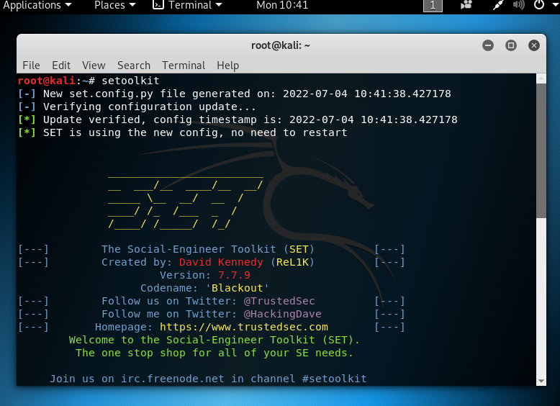
Website cloning using ngrok:
1. setoolkit

Slide 7
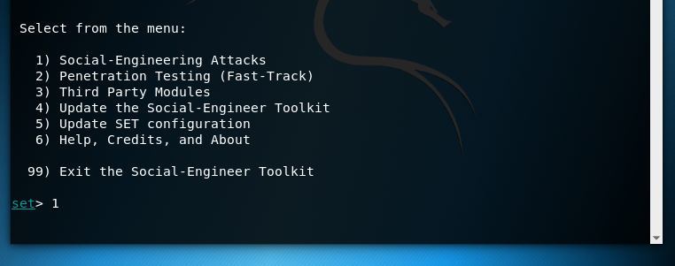
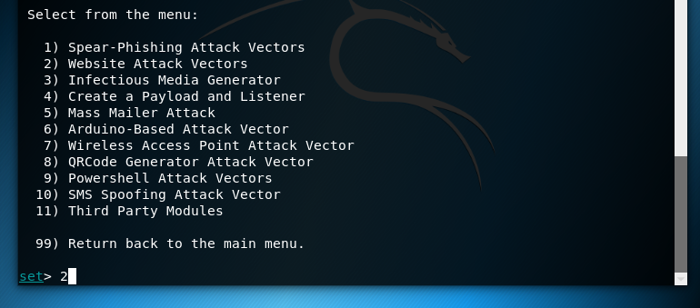

Slide 8

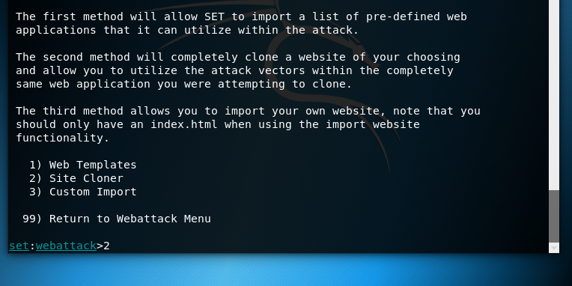

Slide 9
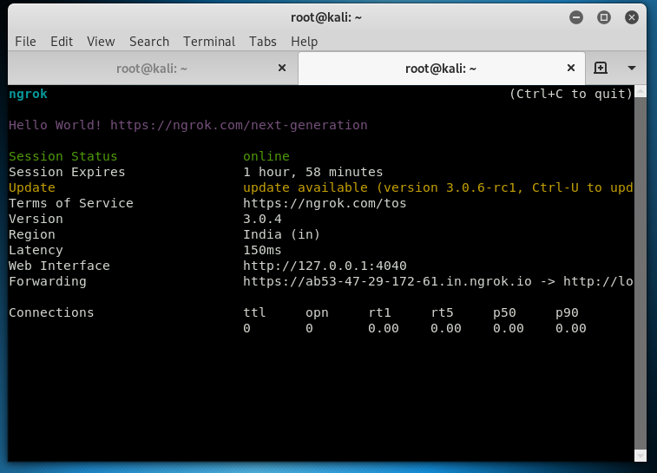
Open a new terminal and type ngrok http 80

Slide 10
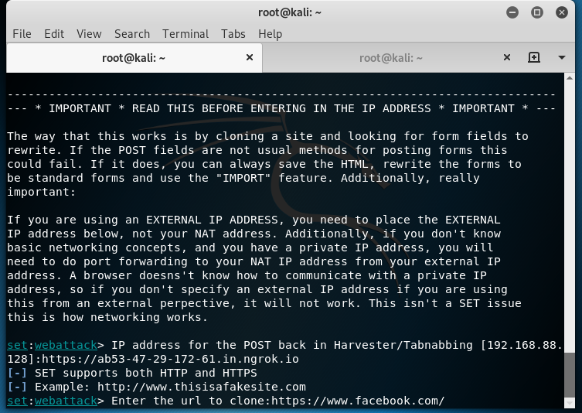
Copy and Use this link

Slide 11
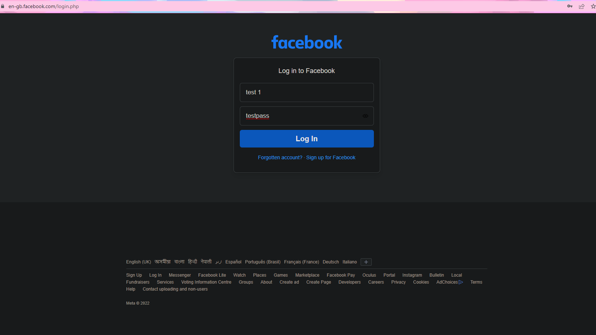
After cloning paste or send this fake link:

Slide 12
